Slide 1




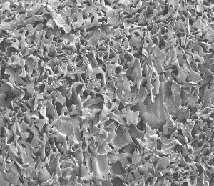
Current opportunities
for international research funding in Ukraine
Prof Sergey Mikhalovsky
Сергій Михаловський
R&D Director
Advanced Nanostructured Materials Design and Consultancy (ANAMAD) Ltd, Brighton, UK
Visiting Professor
University of Southampton, UK
sergeymikhalovsky@gmail.com
ANAMAD Ltd.

Slide 2
Workshop Agenda
Local Time | Subject
Session 1 | Day 1
45 min | Horizon Europe – overview of the main research funding body in the EU
15 min | Q&A session
Session 2
45 min | Current and forthcoming funding opportunities in Horizon-Europe – how to find them?
15 min | Q&A session
 | Q&A are also welcome throughout each presentation

Slide 3
Workshop Agenda (cont.)
Local Time | Subject
Session 3 | Day 2
45 min | Types and structure of research proposals for Horizon Europe. The logistics of proposal assessment and evaluation
15 min | Q&A session
Session 4
45 min | Best practices in grant writing – I. Scientific Excellence
15 min | Q&A session
 | Q&A are also welcome throughout each presentation. Participants will receive a redacted real H-E proposal for practicing its evaluation as experts

Slide 4
Workshop Agenda (cont.)
Local Time | Subject
Session 5 | Day 3
45 min | Best practices in grant writing – II. Impact
15 min | Q&A session
Session 6
45 min | Best practices in grant writing – III. Implementation
15 min | Q&A session
 | Q&A are also welcome throughout each presentation

Slide 5
Workshop Agenda (cont.)
Local Time | Subject
Session 7 | Day 4
45 min | Practice in proposal evaluation
15 min | Q&A session
Session 8
45 min | Overview of other programmes: NATO and COST
15 min | Final remarks, discussion and conclusions
 | Q&A are also welcome throughout each presentation

